Slide 1
Patient Similarity using Relational Graph Convolutional Networks
High Risk Project – Spring 2025
Sonal Pardeshi
Julian E Gomez
Razal Minhas

Slide 2
Agenda
Introduction - EHR Growth and Challenges
Project Overview
Data Preparation
Patient Similarity
Graph Creation
Relational Convolutional Graph Network
Next Steps

Slide 3
Introduction - EHR Growth and Challenges
Explosive growth in medical data from:
Wearable health tracking devices
Digitization of hospital records
Growth in telemedicine
Yet 97% of the data is unused
Challenges in analyzing data:
Data structures and integration as evidenced by the MIMIC initiative
Access and data preprocessing needs
Privacy
Data biases
And others
Notes:
The volume of medical data has experienced explosive growth in recent years, fueled by advances in digital health technologies, widespread adoption of electronic health records (EHRs), the proliferation of wearable devices, and the expansion of telemedicine.
By 2025, healthcare data is projected to reach nearly 10,000 exabytes, with hospitals alone generating an average of 50 petabytes of data per year.
https://www.globenewswire.com/news-release/2025/02/03/3019234/0/en/Healthcare-Data-Monetization-Solutions-Market-to-Worth-Over-US-3-775-85-Million-By-2033-Diverse-Applications-and-Industries-Benefiting-from-Data-Monetization-s-Transformative-Poten.html
Despite the massive volume, up to 97% of healthcare data goes unused, highlighting the untapped potential for improving care and operational efficiency

Slide 4
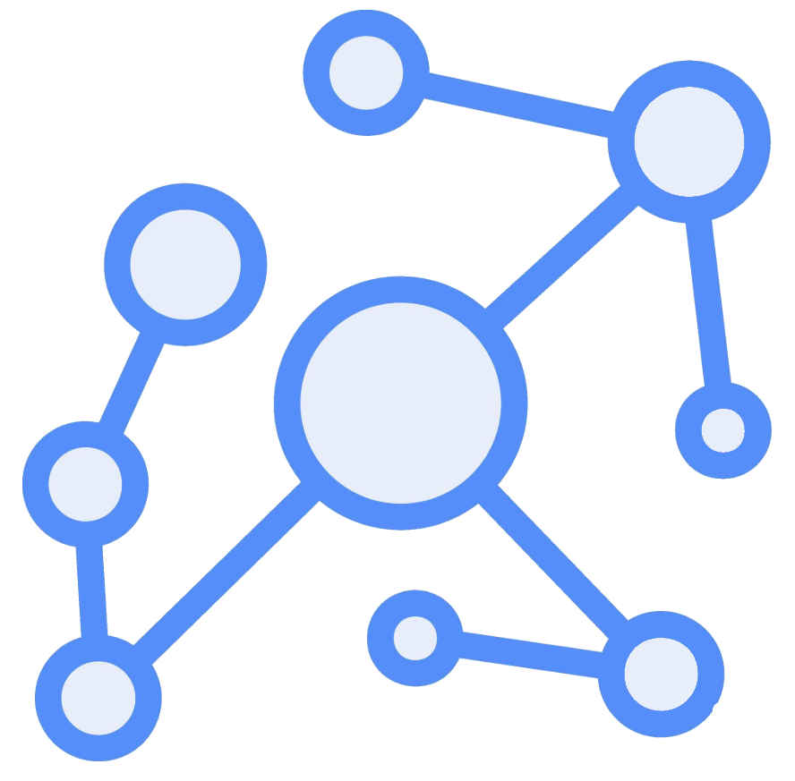

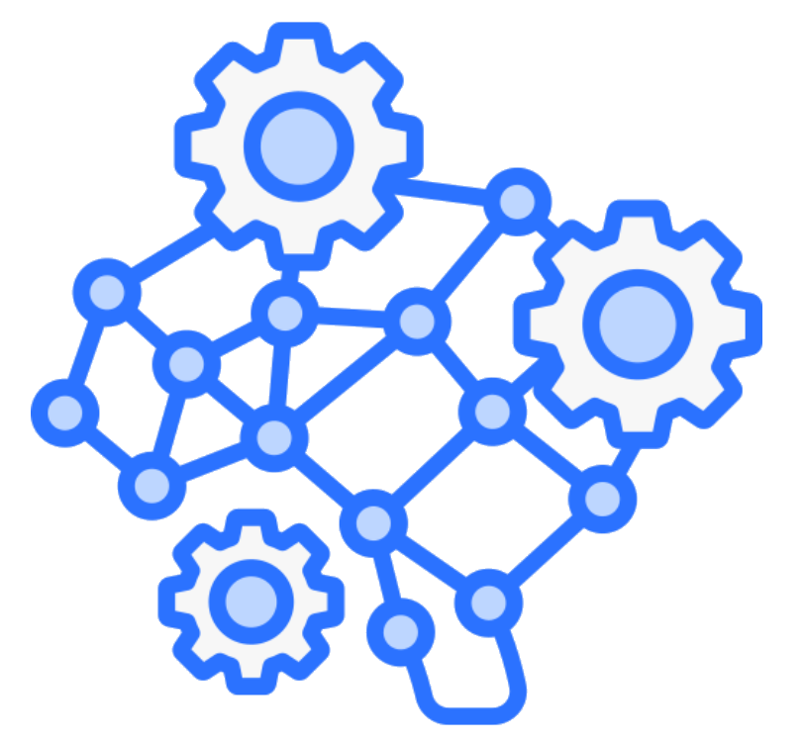
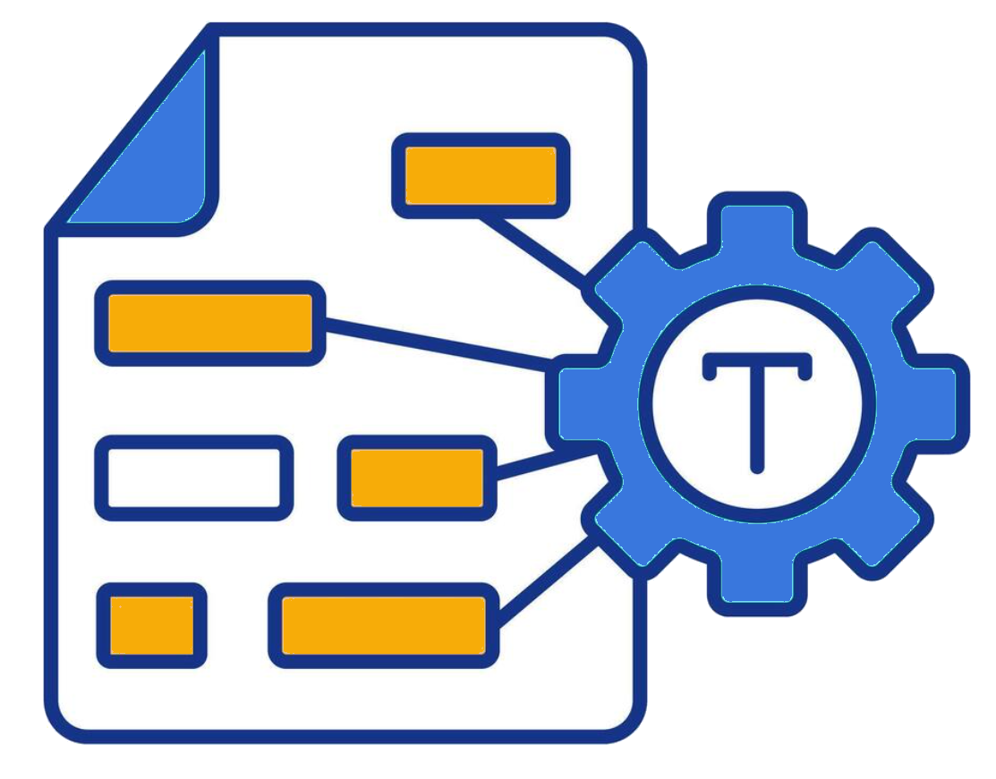
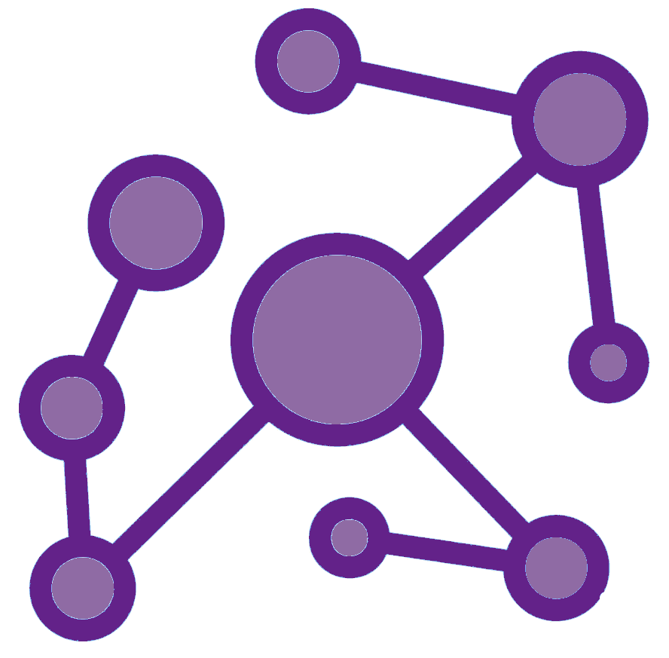
Project Overview
Patient Graph with Diagnosis, etc.
train
MIMIC
test
Vector Embeddings
Patient Similarity Pairings
Relational Graph Convolutional Network
RAG System
We leverage MIMIC-III to hydrate the patient graph using network
We evaluated 1.6M patient pairs using Jaccard similarity to find similar patients
The torch geometric library was used to create the R-GCN which produced patient embeddings
We envision using a RAG system to search the generated embeddings (could not be addressed within the project timeline)

Slide 5
Data Preparation
MIMIC-III has 45k patients associated with 651k procedures and 240k procedures
We down sampled the data to fit the compute available for this project
To manage the project scope, we used each patient's latest hospital admissions and associated diagnoses and procedures
Age bucket was added as a new feature for patients
R-GCNs can leverage heterogenous relationships as well as node features which provide valuable signals which is a benefit over decision tree-based methods

Slide 6
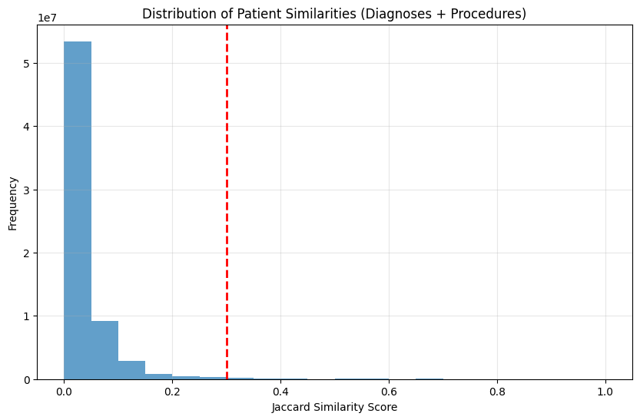
Patient Similarity
Contrastive graph networks use patient similarity to guide the loss functions hence calculating patient similarity is essential
We permuted the patient nodes with diagnosis and procedure relations to analyzed 1.6M patient pairs
Jaccard similarity was used with a 0.3 cut off (patients with similarity score greater than 0.3 were considered similar)

Slide 7
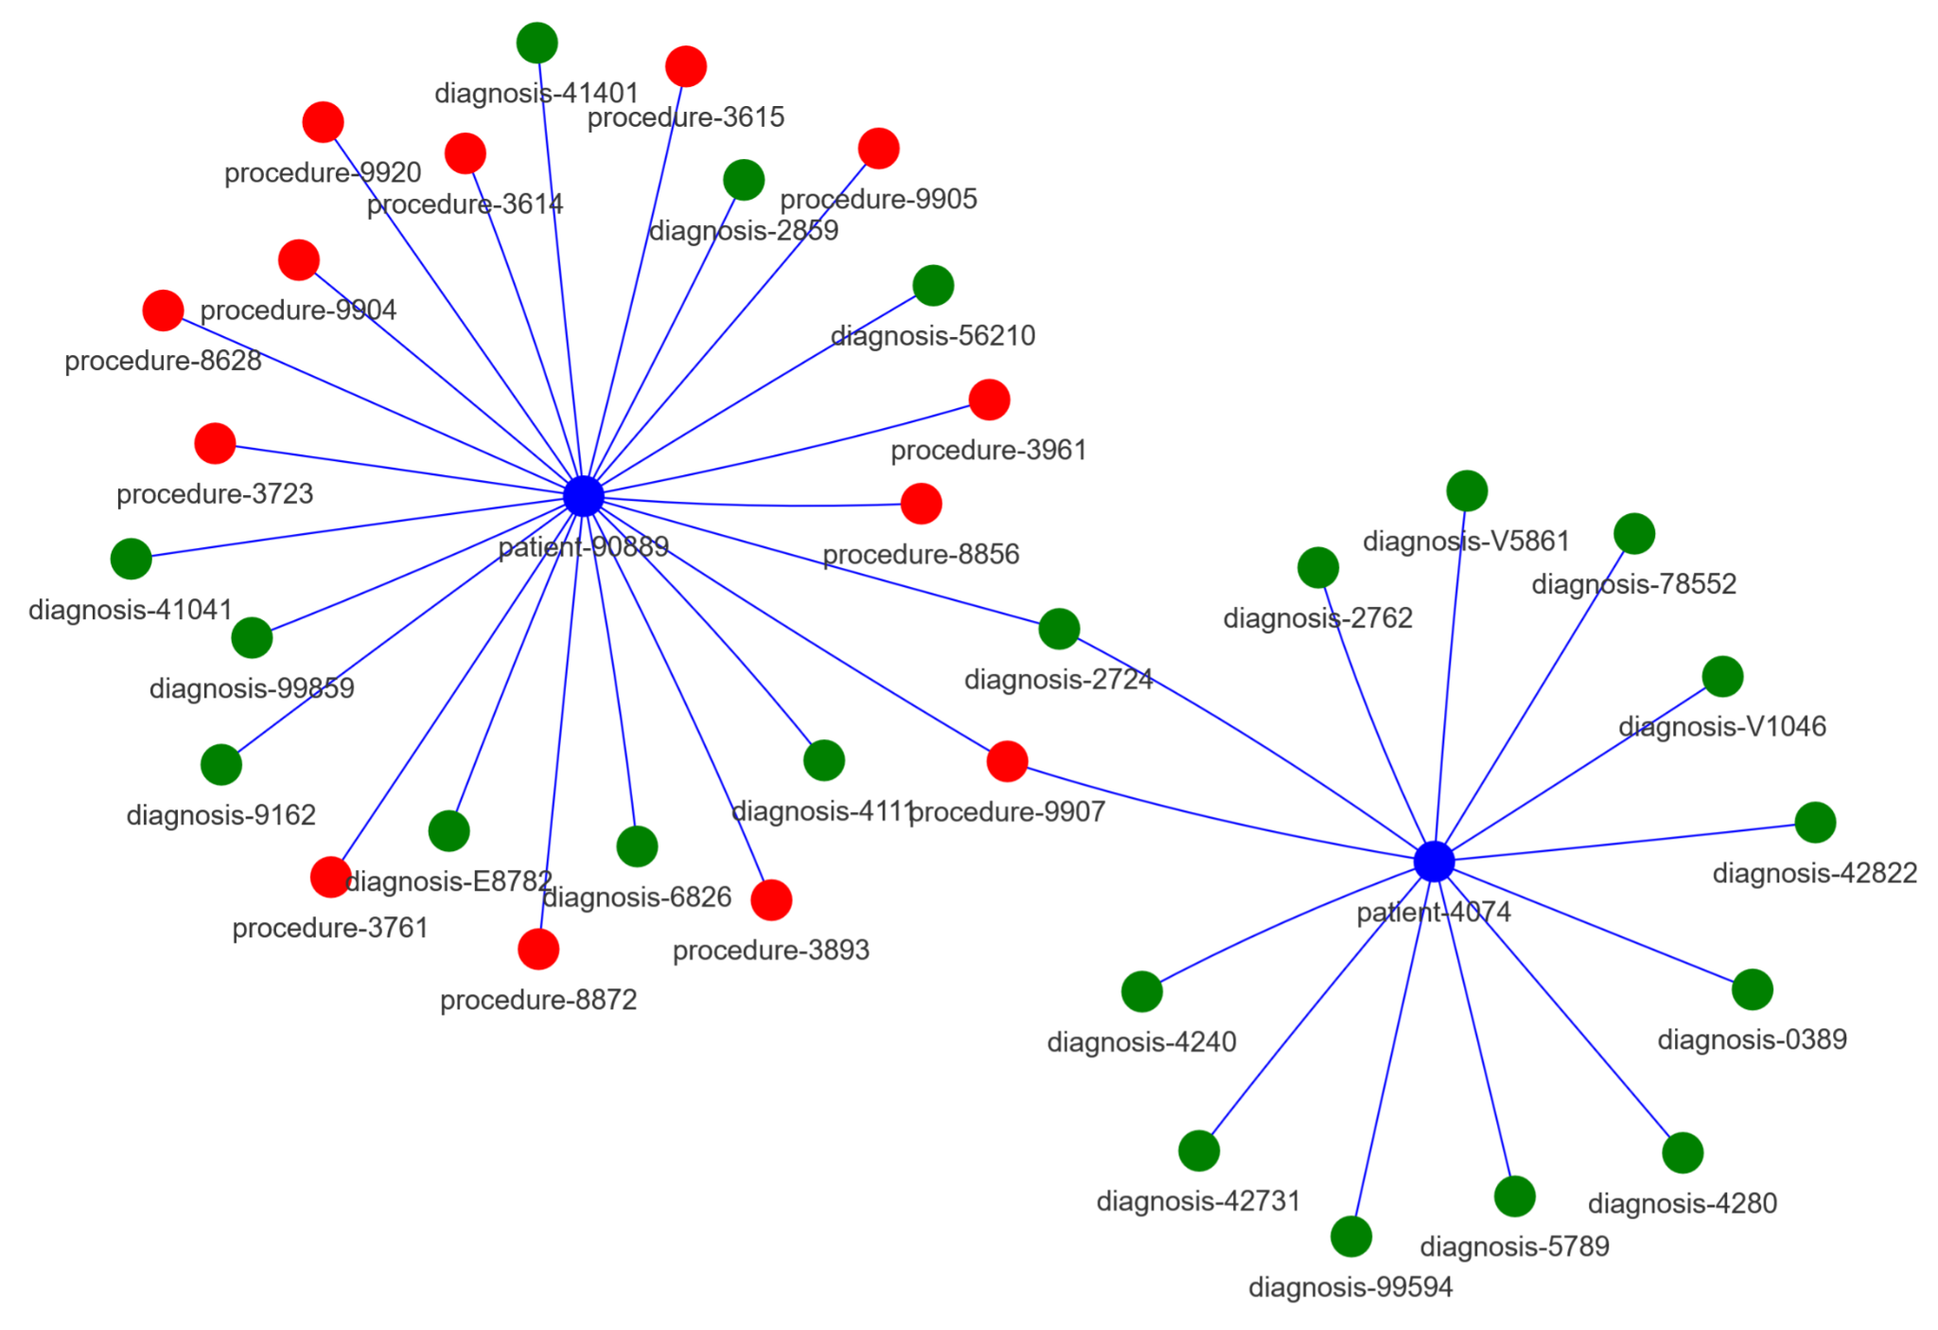
Graph Creation
While recording the video, you can Alt-tab to your browser and show the graph in your browser. It looks cool as you drag nodes. Will spice up the presentation. Looks in the github pyvis folder.
Contrastive graph networks use patient similarity to guide the loss functions hence calculating patient similarity is essential
We permuted the patient nodes with diagnosis and procedure relations to analyzed 1.6M patient pairs
Jaccard similarity was used with a 0.3 cut off (patients with similarity score greater than 0.3 were considered similar)
Graph composed of patient, diagnoses and procedure nodes

Slide 8
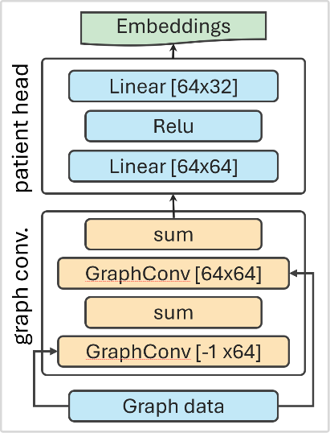
Relational Convolutional Network
R-GCNs extend the message-passing framework of regular GCNs by introducing separate transformation matrices for each relation type
This is suitable for MIMIC-III as our data contains multiple relationship types (edges) and heterogeneous nodes
Contrastive loss was used to calculate the pairwise distance between the embeddings generated by the model.
Validation was carried out by using the 128k Jaccard similarity dataset generated by patient pairwise comparison earlier
Graph relationships (edges) are processed independently

Slide 9
Next Steps
There are numerous opportunities for improving the system:
Additional development within the model to log accuracy and further tune the model which could not be addressed within the project timeline
Leveraging a graph database (such as Neo4j or Cloud Spanner) to persist the graph for continuous updates with new patient data
Creation of a RAG system that is frequently refreshed with a user interface for physicians
Addition of edges and nodes to mimic the complete structures present in MIMIC-III
Analysis and mining of physician notes for diagnosis, procedure and patient nodes.

